Slide 1





User-defined functions, procedures and triggers, Transactions
Databases
Basics
SoftUni Team
Technical Trainers
Software University
http://softuni.bg

Slide 2
Questions
sli.do #5604

Slide 3

Table of Contents
Creating and executing user defined function
Dropping user defined functions
Creating and executing stored procedures
Dropping stored procedures
Creating triggers
Dropping triggers
Starting transactions

Slide 4

Functions

Slide 5
CREATING & EXECUTING FUNCTIONS

Slide 6
MySQL – Creating Functions
CREATE FUNCTION function_name (parameter parameter_type, … )
RETURNS return_type
BEGIN
…SQL statements
RETURN (result);
END

Slide 7
MySQL – Excuting functions
SELECT function_name (parameters);
SET @variable_name = function_name (parameters);

Slide 8
MSSQL Server – Create Functions
CREATE FUNCTION FunctionName (@VariableName VariableType, … ) RETURNS ReturnType
AS
BEGIN
…SQL Statements
RETURN (result);
END

Slide 9
MSSQL Server – Execute Functions
SELECT FunctionName(parameters);
DECLARE @VariableName VariableType
SET @VariableName = FunctionName(parameters);

Slide 10
DROPPING FUNCTIONS

Slide 11
MySQL – Dropping Functions
DROP FUNCTION function_name

Slide 12
MSSQL Server – Dropping Functions
DROP FUNCTION FunctionName

Slide 13

Stored Procedures

Slide 14
What are Stored Procedures?
Stored procedures are named sequences of SQL statements
Encapsulate repetitive program logic
Can accept input parameters
Can return output results
Benefits of stored procedures
Share application logic
Improved performance
Reduced network traffic

Slide 15
CREATING & EXECUTING PROCEDURES

Slide 16
SQL Server – Creating stored procedures
USE databaseName
GO
CREATE PROC procedureName
AS
SELECT *
FROM tableName
WHERE …
GO

Slide 17
SQL Server – Executing Stored Procedures
EXEC procedureName
INSERT INTO tableName
EXEC procedureName

Slide 18
MySQL – Creating stored procedures
DELIMITER $$
CREATE PROCEDURE procedure_name ()
BEGIN
--SQL Expressions
END$$
DELIMITER ;

Slide 19
MySQL – Executing Stored Procedures
CALL procedure_name
INSERT INTO table_name
EXEC procedure_name

Slide 20
Altering Stored Procedures
Use the ALTER PROCEDURE statement
USE SoftUni
GO
ALTER PROC usp_SelectEmployeesBySeniority
AS
SELECT FirstName, LastName, HireDate,
DATEDIFF(Year, HireDate, GETDATE()) as Years
FROM Employees
WHERE DATEDIFF(Year, HireDate, GETDATE()) > 5
ORDER BY HireDate
GO

Slide 21
DROPPING PROCEDURES

Slide 22
SQL Server – Dropping Stored Procedures
DROP PROC procedureName
EXEC sp_depends 'usp_SelectEmployeesBySeniority'
Notes:
DROP PROCEDURE
DROP PROC procedureName
You could check if any objects depend on the stored procedure by executing the system stored procedure sp_depends
EXEC sp_depends 'usp_SelectEmployeesBySeniority'

Slide 23
MySQL – Dropping Stored Procedures
DROP PROCEDURE [IF EXISTS] procedureName

Slide 24

Triggers

Slide 25
What Are Triggers?
Triggers are very much like stored procedures
Called in case of specific event
We do not call triggers explicitly
Triggers are attached to a table
Triggers are fired when a certain SQL statement is executed against the contents of the table
E.g. when a new row is inserted in given table

Slide 26
CREATING TRIGGERS

Slide 27
SQL Server Types of Triggers
After
Instead of
Trigger
Trigger
Event
Event
Event
Notes:
SQL SERVER Types of Triggers
There are two types of triggers
After triggers
Instead-of triggers
After triggers
Fired when the SQL operation has completed and just before committing to the database
Instead-of triggers
Replace the actual database operations
Inside the triggers you can access special tables "inserted" and "deleted" to modify the event.

Slide 28
After Triggers
CREATE TRIGGER tr_TownsUpdate ON Towns FOR UPDATE
AS
IF (EXISTS(SELECT * FROM inserted WHERE Name IS NULL) OR
EXISTS(SELECT * FROM inserted WHERE LEN(Name) = 0))
BEGIN
RAISERROR('Town name cannot be empty.', 16, 1)
RETURN
END
GO
UPDATE Towns SET Name='' WHERE TownId=1
This will cause an error
Notes:
Also known as "for-triggers" or just "triggers"
Defined by the keyword FOR

Slide 29
Instead Of Triggers
Users
Username | Password | Active
Ivan_ko | ****** | Y
Dragon123 | ****** | N
… | … | …
DELETE FROM Users
WHERE Username = 'Dragon123'
Username | Password | Active
Ivan_ko | ****** | Y
Dragon123 | ****** | Y
… | … | …
CREATE TRIGGER tr_AccountsDelete ON Accounts
INSTEAD OF DELETE
AS
UPDATE a SET Active = 'N'
FROM Accounts a
JOIN deleted d
ON d.Username = a.Username
WHERE a.Active = 'Y'

Slide 30
MySQL Types of Triggers
Before
After
Trigger
Trigger
Event
Event
Notes:
There are two types of triggers
After triggers
Before triggers
Key words for getting data inside them are NEW and OLD

Slide 31
After Triggers
CREATE TRIGGER trigger_name
AFTER {INSERT | UPDATE | DELETE}
ON table_name
FOR EACH ROW
BEGIN --SQL Statements END

Slide 32
Before Triggers
CREATE TRIGGER trigger_name BEFORE {INSERT | UPDATE | DELETE }
[{FOLLOWS | PRECEDES}] other_trigger_name
ON table_name
FOR EACH ROW
BEGIN
--SQL Statements
END

Slide 33
DROPPING TRIGGERS

Slide 34
SQL Server – Dropping Triggers
DROP TRIGGER [ IF EXISTS ] [schema_name.]triggerName

Slide 35
MySQL – Dropping Triggers
DROP TRIGGER [IF EXISTS] [schema_name.]trigger_name

Slide 36
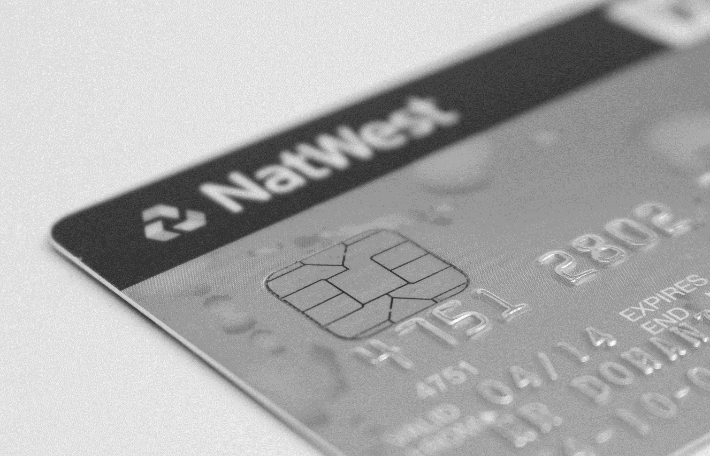

Transactions

Slide 37
What are Transactions?
Sequence of actions executed as a whole
All of them
complete successfully
None of the them
complete successfully
Notes:
Transaction is a sequence of actions (database operations) executed as a whole:
Either all of them complete successfully
Or none of the them
Example of transaction:
A bank transfer from one account into another (withdrawal + deposit)
If either the withdrawal or the deposit fails the whole operation is cancelled

Slide 38
Transactions and SQL
COMMIT
BEGIN
TRANSACTION
ROLLBACK
Notes:
Start a transaction
BEGIN TRANSACTION
Some RDBMS use implicit start, e.g. Oracle
Ending a transaction
COMMIT
Complete a successful transaction and persist all changes made
ROLLBACK
“Undo” changes from an aborted transaction
May be done automatically when failure occurs

Slide 39

Demo in SQL Server

Slide 40
Demo in MySQL

Slide 41

Summary
User defined functions and store procedures save code repetition.
Create triggers that apply a given behavior when some condition has occurred.
Use transactions if we want to be sure that if all the behavior goes as planned
Notes:
We can create user defined functions and store procedures in both MySQL and SQL Server and we can easily execute them to save code repetition.
We can create triggers that apply a given behavior when some condition has occurred.
We can make transactions if we want to be sure that if all the behavior goes as planned, all the changes are made and in the other case, no changes are applied.

Slide 42









Functions, Triggers and Transactions
https://softuni.bg/courses/

Slide 43
License
This course (slides, examples, demos, videos, homework, etc.) is licensed under the "Creative Commons Attribution-NonCommercial-ShareAlike 4.0 International" license
Attribution: this work may contain portions from
"Databases" course by Telerik Academy under CC-BY-NC-SA license

Slide 44





Free Trainings @ Software University
Software University Foundation – softuni.org
Software University – High-Quality Education, Profession and Job for Software Developers
softuni.bg
Software University @ Facebook
facebook.com/SoftwareUniversity
Software University @ YouTube
youtube.com/SoftwareUniversity
Software University Forums – forum.softuni.bg

